Slide 1
meetchewthere
Lab Usability Study

Slide 2
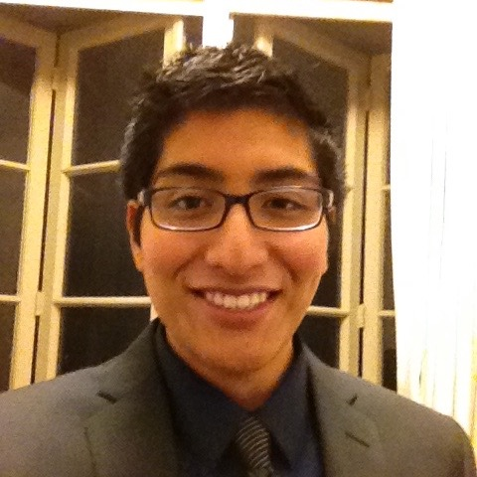



The Team
Michael
Cruz Doshi
Bronwyn
Early
Alejandrina
Gonzalez Reyes
Senthilnathan Viswanathan

Slide 3
Prototype Changes

Slide 4


Changed entire codebase

Slide 5
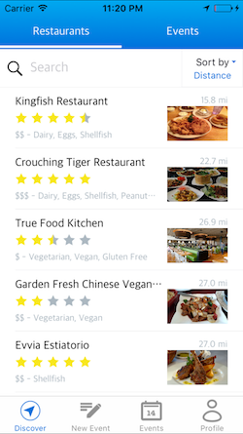
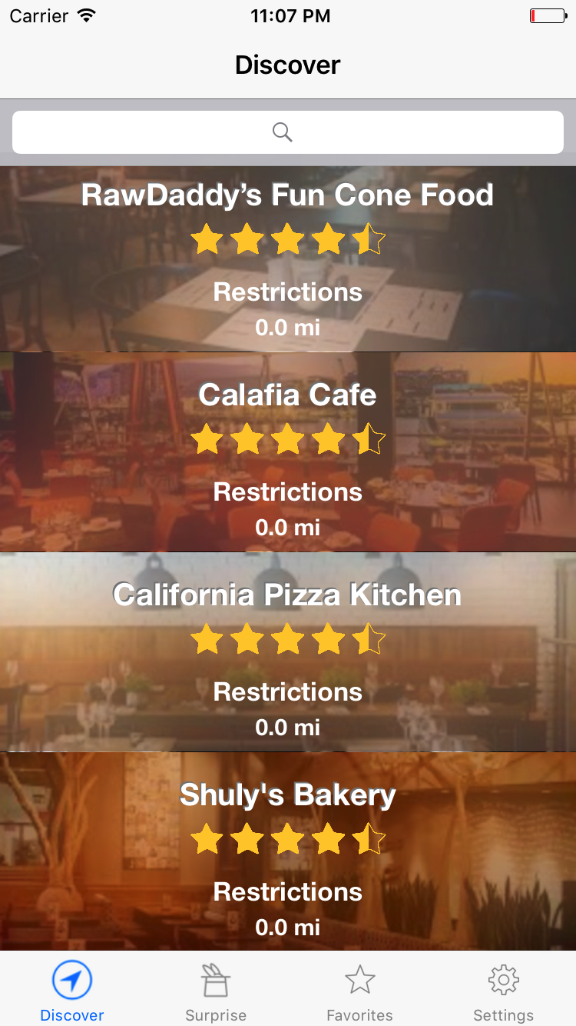
List view

Slide 6
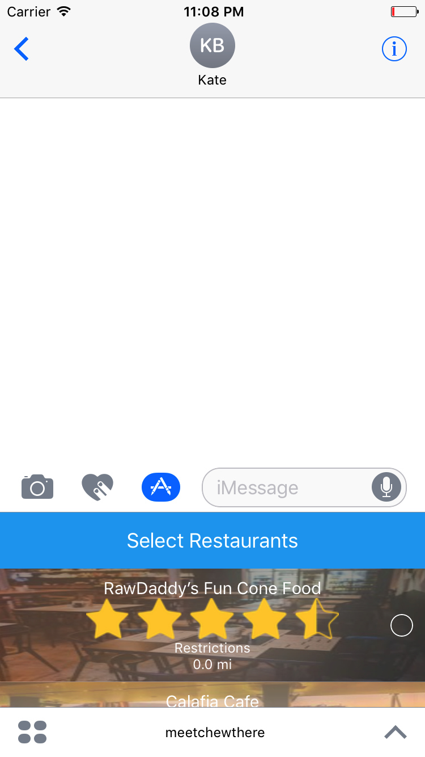
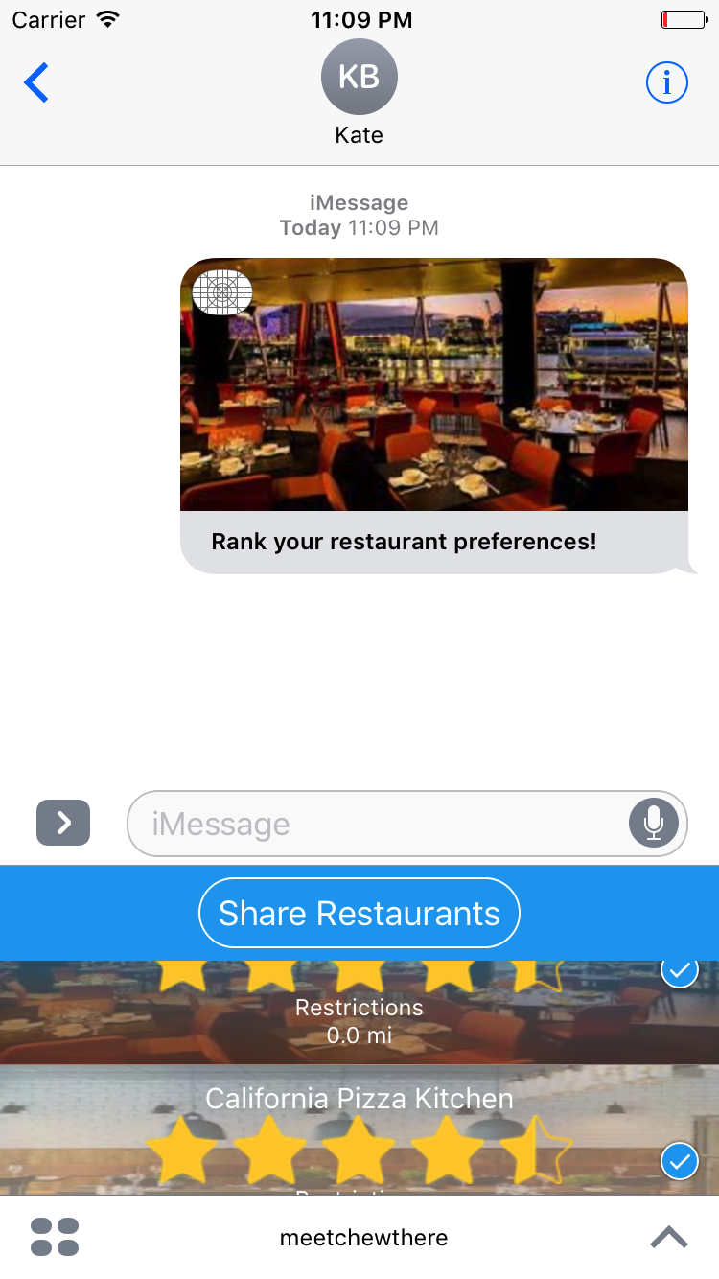
From Events to Sharing

Slide 7
Method

Slide 8
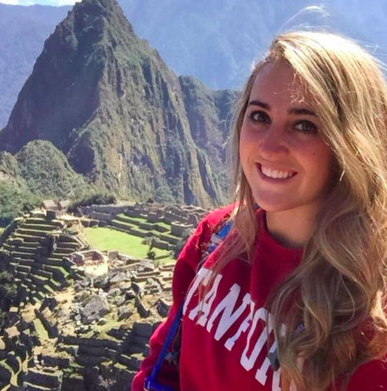
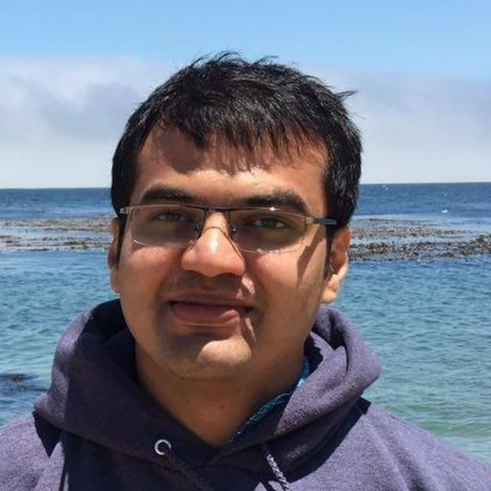

Study Participants
Selected target users with different dietary restrictions
No Compensation
Maddie Hawkinson
Deathly peanut allergy
Loves to travel
Yash Vyas
Grad Student
Vegetarian
Lauren Newby
Various intolerances
Eating + mental health
Peter Wally
Works out a lot!
Gluten Intolerance

Slide 9
Apparatus
Downloaded the apps on our iPhones and recorded their use
Tested in person at their residence or common place they picked

Slide 10
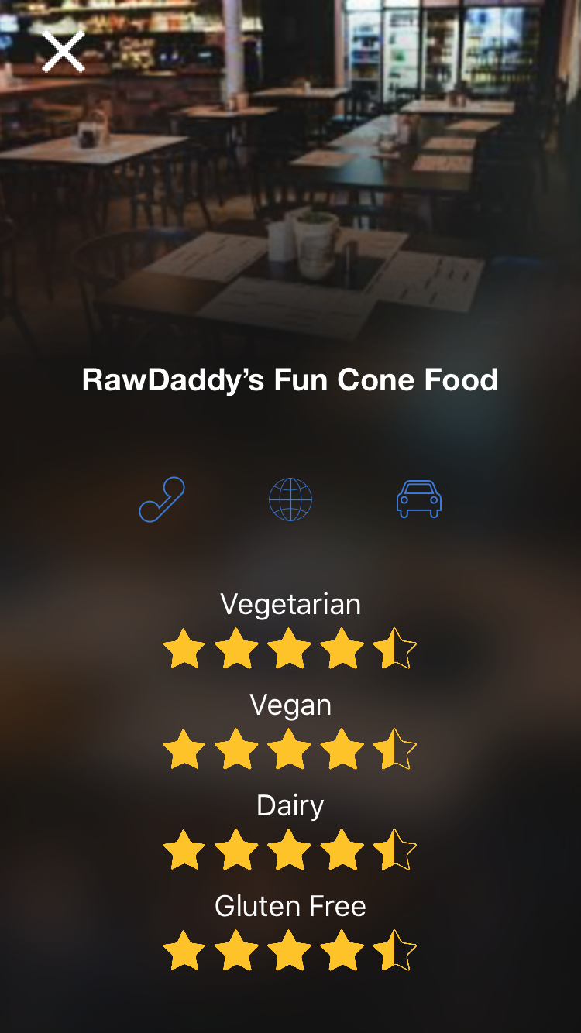
Task 1
Find Food
Locate restaurants that fit your dietary restrictions
Quickly find restaurants to fit their restrictions

Slide 11
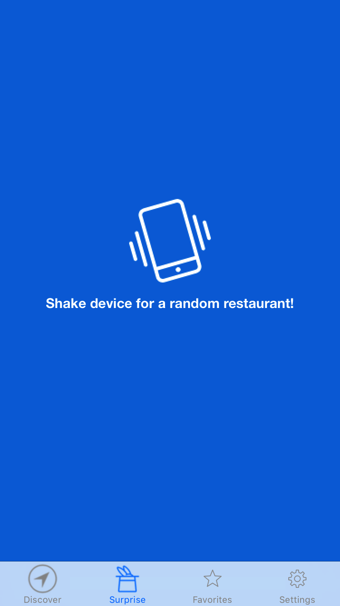
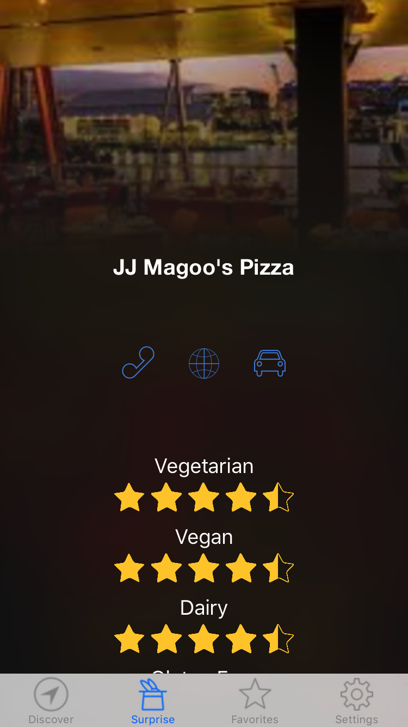
Task 2
Explore New Places To Eat
Shake and be surprised!
Enjoyed finding a new restaurant + Had enough information + Time

Slide 12
Task 3
Share With Friends
Share your options with a group
Fluidly share with their friends, examine how their approach

Slide 13
Procedure
Intro
Why use meetchewthere?
Preface work in progress, some faked data, etc
Tasks: Repeated for each task
Explain concept
Ask them to perform the task
Let them explore the app further
Monitor what they do until success
Intervention wasn’t necessary

Slide 14
Test Measures
All tasks:
Time to complete
# of noticeable hesitations
# of questions
Task 1
Was search component used?
Task 2
How many times did they shake till they found something they liked?
Enjoying themselves? (soft metric)
Task 3
Did they find the iMessage extension?

Slide 15
Results

Slide 16
Task 1: Find Restaurant through Search
Search relatively easy, familiar
< 20 seconds before decided they were “done”
Lack of clear finish lead to questions
Different search styles for different types of scenarios and restrictions
Filters vs search
3x question of how data would be inputed
More questions for more harsher restrictions
Wanted more data!

Slide 17
Task 2: Shake to Find
Average of 4 tries to find a restaurant
Different levels of engagement
3x the question of filters
Inconclusive responses to actual desire to use this feature in the future

Slide 18
Task 3: Share with Friends
~30 seconds before getting stuck
Not a great deal of features in app - not many features to try
Prompted about iMessage extension
No middle ground in number of hesitations
Either understood format of iMessage extension or not
Navigation to the extension took almost as much time and more of the hesitation than the actual app portion

Slide 19
Discussion

Slide 20
Filters vs Search
Filters absolutely desired
Core group doesn’t need them - filters always the same
Expansion would like them, doesn’t hurt other group
Shaking should be filtered
Discovery through search, not shake
Change Location!

Slide 21
All Things Data
Desire for modifying and reporting on the data
Add report button
Add your own rating
Entire rating mode?
Customize what data you see
More extensive profile page
More data desired

Slide 22
Sharing works, if iMessage works
Familiarity with iMessage extension was exactly related to ease and enthusiasm for share component
Incorporate sharing directly into the app
From Favorites
From restaurant directly
Option to add to List or send directly
Plenty of scenarios in which iMessage doesn’t work
Incorporate lists into other messaging systems

Slide 23
Summary
More feature development in searching and discovery
More data, both for and from users
Need for deeper sharing capabilities

Slide 24
Questions?

